Slide 1


Evolution of the s&p 500 from 2016 to 2024

Slide 2

outline
Executive Summary
Introduction
Methodology
Results
Closing price during 2016 – 2024
Closing Price with Months and years
Volatility
Volume for the years 2016 to 2024
Volume for the years 2016 to 2024
Correlation between volume and closing price
Interactive Dashboard
Discussion, Findings and Implications
Conclusion
Appendix

Slide 3
Executive summary
This study is about the rise of the Closing Price of the S&P 500 ETF during the months of January and February 2024.
It reached a maximum at this period.
The reason evoked, is the higher production of semiconductors used for AI, by American industries such as NVIDIA and Qualcomm.
This study shows that the 1st election of former President Donald Trump did not affect the performance of S&P 500 Closing Price. We can suppose that another win by Donald Trump will not affect the index. However, some cautions are needed.
This increment in the Closing Price, represents a better insight about inflation in the USA and the Euro Zone. But rates are still higher to maintain low inflation rates.

Slide 4
Introduction
S&P 500 and Dow Jones Industrial are two of the more important ETFs in the World.
They are a good indicator of the USA economic health.
S&P 500 gathers the top 500 companies of the USA.
Since elections in the USA and around the World approach, we want to know if the election of a new POTUS will affect the performance of the S&P 500.
Donald Trump seems to be a strong candidate for the final stages of the 2024 Election.
Therefore, we will see if his 1st election affected the performances of the S&P 500.
Hence, we will study the evolution of the Closing Price of the S&P 500 from January 2016 to January 2024.
We will determine if it is safe to invest only in the S&P 500 or to consider different financial instruments.

Slide 5
Methodology
Data was collected from Yahoo Finances API, using the Ticker ^GSPC for S&P 500.
Line plots and a pie plot were used to illustrate the evolution of the S&P 500 for the period 2016-2024.
A scatter plot was used to observe the possible correlation between Volume and Closing Price.
A Dashboard is used to interact with plots and aim precise periods.

Slide 6
results

Slide 7

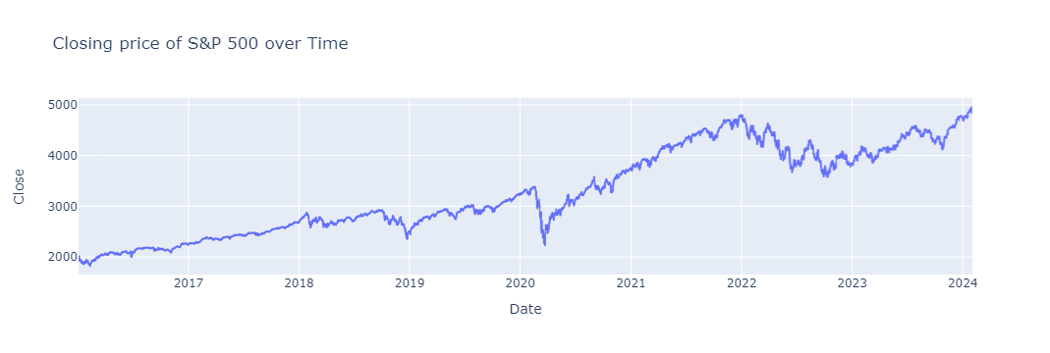
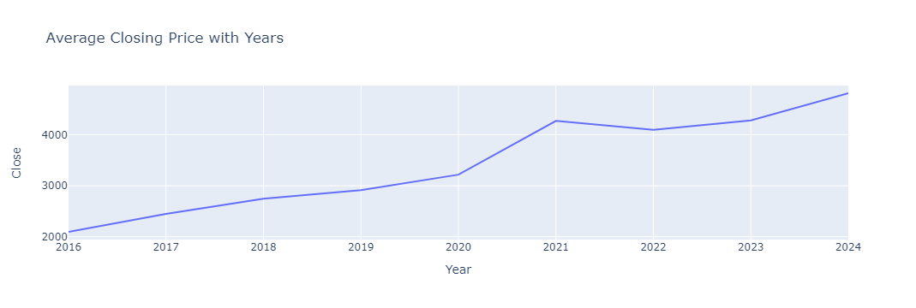
Closing price during 2016 - 2024
S&P rose between 2016 and 2024.
Conflicts in Ukraine (February 2022) and Palestine (October 2024) did not affect the performance of the S&P 500.
The election of Donald Trump in November 2016 did not affect the performance of the S&P 500.
S&P 500 went down during COVID-19 (March 2020).
On average, S&P 500 rose from 2000 to 4900 between 2016 and 2024.

Slide 8
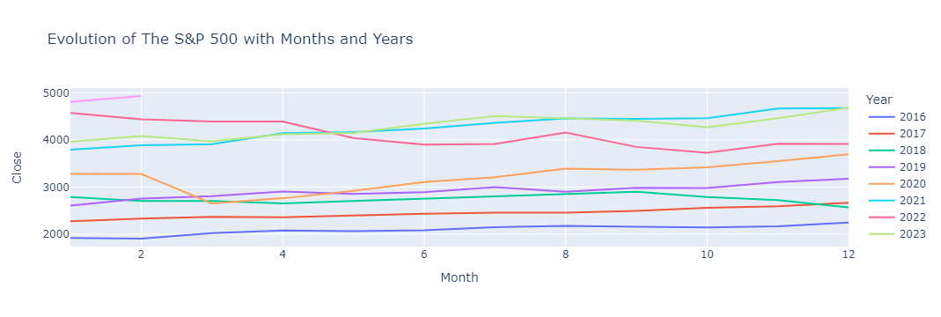
Closing Price with Months and years
The closing price went up after 2020.
The maximum price is reached for 2024 at 4.9 k.

Slide 9
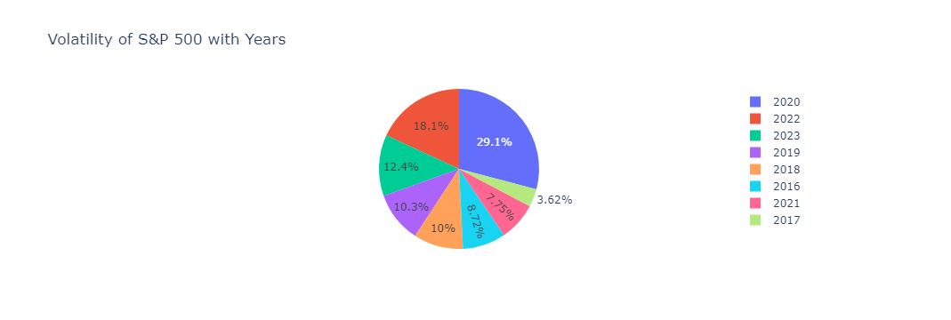
Volatility
Volatility was higher for 2020.
It was lower for 2017.
After 2020, Volatility went down to 7.75 % for 2021.
Rose again to 18.1 % for 2022
Decreased to 12.4 % for 2023.

Slide 10
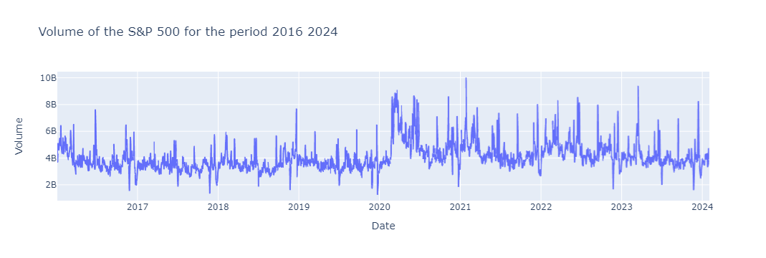
volume for the years 2016 to 2024
Volume is not showing a significant pattern.
It went up during March 2020 because of COVID -19.

Slide 11
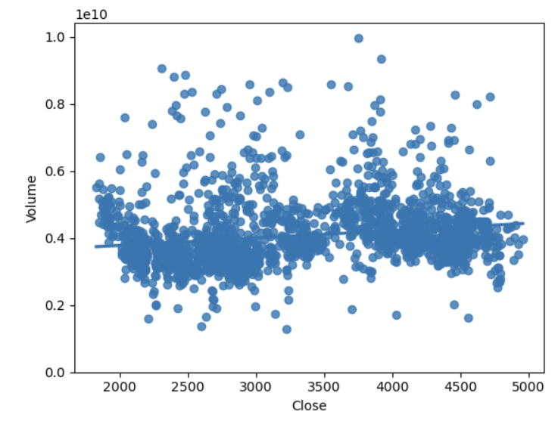
Correlation between volume and closing price
The correlation coefficient between Volume and Closing Price is 0.19.
Since the correlation coefficient is close to 0, we can state that there is no correlation between Volume and Closing Price.
Data is importantly dispersed around the regression line.
From the plot, we can see that there is no correlation between Volume and Closing Price.

Slide 12
Interactive Dashboard

Slide 13
Interactive Dashboard
The following dashboard is used to actively study data

Slide 14
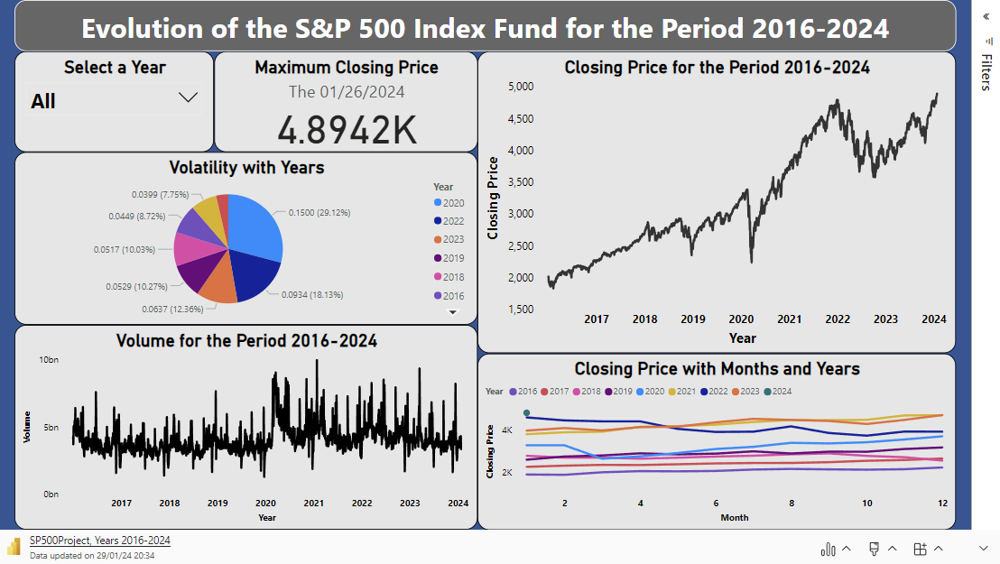

Slide 15
DISCUSSION, findings and implications

Slide 16
discussion
The S&P 500 went up to a historical level of 4.9 k in January – February 2024 due to NVIDIA processors used for AI and the semi-conductor companies like Qualcomm.
COVID-19 did not seem to affect the progress of the S&P 500. → This implies that economy is growing despite a slow production for the years 2020-2022.
Volume is lower compared to previous years because the Closing price is at its maximum
It was the converse during the COVID-19 era, where it was high during March 2020.

Slide 17
Future implications
The increasing in the index of the S&P 500 shows that supplying, and production of the American economy is well behaving as told by the FED Chair Jerome Powell.
Therefore, Headline CPI went down from 6.4 in January 2023 % to 3.4 % in December 2023.
However, the FED is still cautious about rate decreasing, to maintain low inflation rates.
In Europe, ECB Chair, Christine Lagarde is more cautious with rates drop, since The Euro Zone experienced stagflation in December 2023. Therefore, ECB is committed to a data-dependent approach and will make decisions on a meeting-by-meeting basis. However, she said that ECB is positive about decreasing rates in summer 2024.

Slide 18
Future implications
Forecast an ETF Index prices can be done by different means. However, some future events must be considered:
Growing inflation caused by wars in Ukraine and Palestine.
Blocking of Suez Channel by the Houthi movement.
Future elections around the World in 2024 (USA, EU, Mexico, Africa, Asia, Oceania, etc..)

Slide 19
Future implications
Because of the present and future instabilities, and the inflation, Benjamin Graham recommends to invest in Government Bonds:
Mexico is going to emit bonds to finance future projects before the actual President Andrés Manuel López Obrador leaves the charge.

Slide 20
Future implications
It is out of the scope of this study to forecast the Closing Price, but it is better to use Neural Networks (LSTM model), instead of ARIMA, because stock prices are not stationary.
Refer to the data science team.

Slide 21
conclusion
For the period 2016-2024, the Closing Prices of the S&P 500 were not affected by the 1st election of the former President Donald Trump, so it is expected that no change will occur if he wins again.
Instead of a decrease during March 2020, COVID-19 didn’t seem to affect the further performances of the S&P 500 Closing Price. Conversely, the prices rose above the previous January 2020 levels.
The Closing price increased for the years following the COVID-19 period and it reached a maximum of 4.9 k in January 2024.
This maximum is due to semiconductor and processor industries, since they are producing technology used for further AI applications.
Volatility reached its high value for 2020 and decreased thereafter.
There is no linear relationship between Volume and Closing Prices.

Slide 22
conclusion
The increase in the Closing prices of the S&P 500 represents a decrease in the US inflation rates, since they reflect an improvement in supplying and production.
However, the FED is still oriented to maintain higher rates, so inflation will decrease to 2 % in 2024.
In the EU Zone, the ECB is struggling to drop inflation and warns investors about excepting rate to decrease. However, Cristine Lagarde is positive about rates going down in Summer 2024.

Slide 23
appendix

Slide 24
